Slide 1
CS174A Lecture 8

Slide 2
Announcements & Reminders
Midterm guide, book questions (no solutions), and sample questions available in Canvas
2/04/24: A2 due; will be discussed during this week’s TA session
2/06/24: Lecture will be on Zoom, not in-person, no quiz, recorded
2/07/24&2/08/24 (Noon-1PM): Office hours, Zoom, not recorded
2/08/24: Midterm Exam: 6:00-7:30 PM PST, in person, in class
2/25/24: A3 due
Team project:
2/28/24: initial project proposals & teams due
3/01/24: midway demo

Slide 3
Last Lecture Recap
Spaces:
Model space
Object/world space
Eye/camera space
Projection Space
Screen space

Slide 4
Next Up
Projections: parallel and perspective
Parallel and perspective view volumes
Canonical (normalized) view volume
Geometric Calculations
Midterm
Hidden Surface Removal
Backface Culling
Lighting
Flat and Smooth Shading: introduction

Slide 5
Rendering Pipeline
MODEL
SPACE
Transformation
Matrix (TM)
WORLD
SPACE
Eye
Matrix (EM)
EYE
SPACE
Translation, Scaling, Rotation, Shear
Eye, COI, Top/Tilt
Window-To-Viewport Mapping (WTV)
Projection
Matrix (PM)
SCREEN
SPACE
PROJECTION
SPACE
????
????

Slide 6
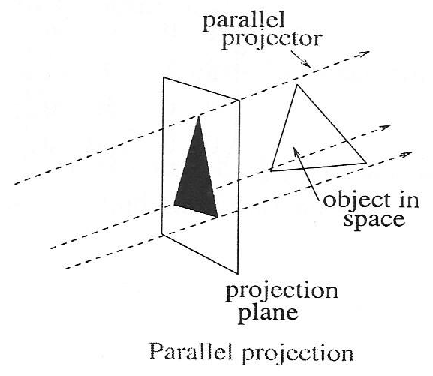
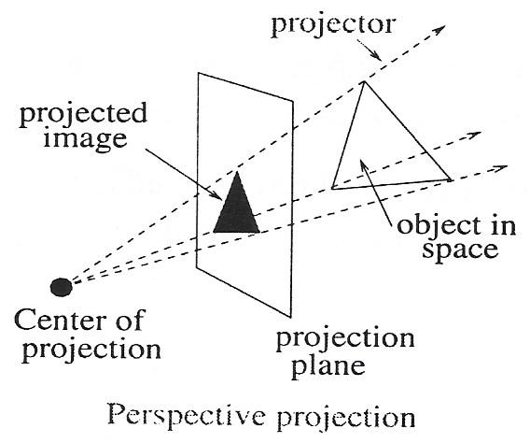
Orthographic Projections

Slide 7
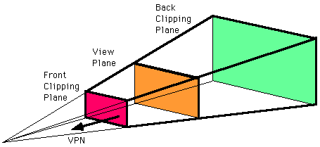
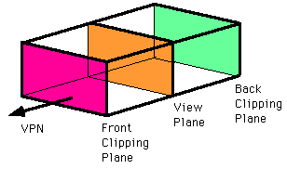
Orthographic Projections View Volumes

Slide 8
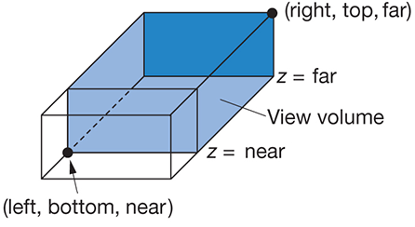
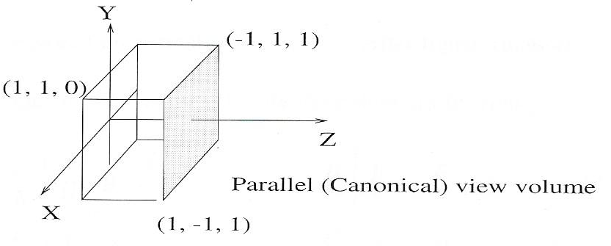

Parallel Projection
View Volume
-W <= X <= W
-H <= Y <= H
N <= Z <= F
D = F - N
Parallel PM = $\left[\begin{matrix}1 & 0 & 0 & 0 \\ 0 & 1 & 0 & 0 \\ 0 & 0 & 1 & 0 \\ 0 & 0 & 0 & 1\end{matrix}\right]$

Slide 9

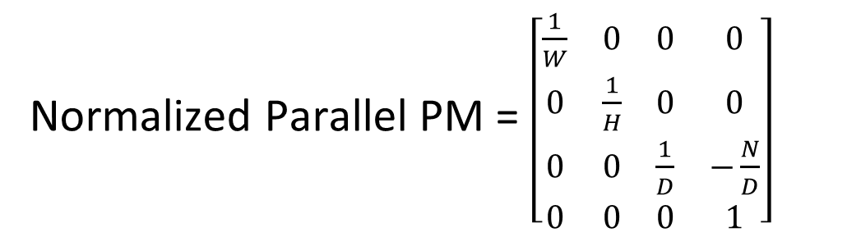
Parallel Projection
Parallel PM = $\left[\begin{matrix}1 & 0 & 0 & 0 \\ 0 & 1 & 0 & 0 \\ 0 & 0 & 1 & 0 \\ 0 & 0 & 0 & 1\end{matrix}\right]$
View Volume
-W <= X <= W
-H <= Y <= H
N <= Z <= F
D = F - N
Normalized Parallel PM = $\left[\begin{matrix}\frac{1}{W} & 0 & 0 & 0 \\ 0 & \frac{1}{H} & 0 & 0 \\ 0 & 0 & \frac{1}{D} & −\frac{N}{D} \\ 0 & 0 & 0 & 1\end{matrix}\right]$
Canonical View Volume
-1 <= X’ <= 1
-1 <= Y’ <= 1
0 <= Z’ <= 1

Slide 10
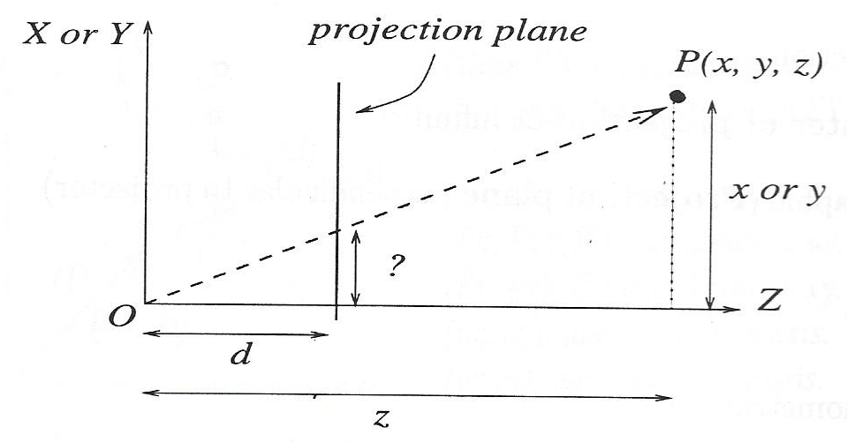


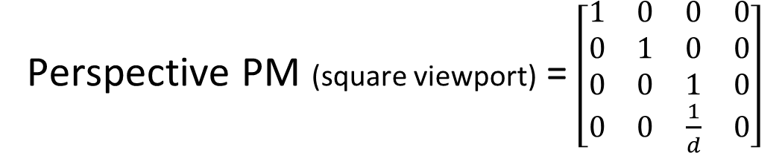
Perspective Projection
$$x′=\frac{x}{z}d$$
$$y′=\frac{y}{z}d$$
X’=
Perspective PM (square viewport) = $\left[\begin{matrix}1 & 0 & 0 & 0 \\ 0 & 1 & 0 & 0 \\ 0 & 0 & 1 & 0 \\ 0 & 0 & \frac{1}{d} & 0\end{matrix}\right]$

Slide 11
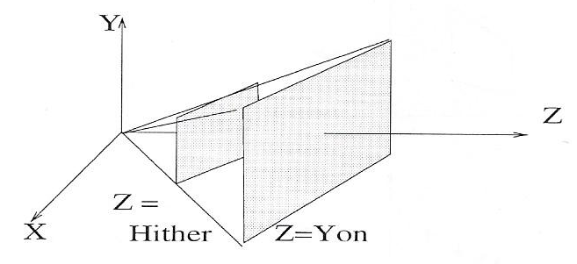
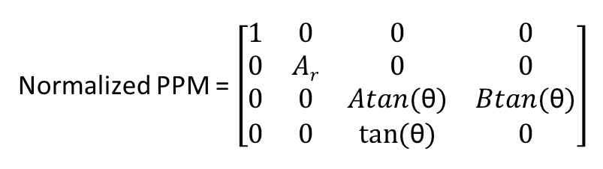

Perspective Projection
Aspect Ratio (A_{r}) = $\frac{W}{H}$
Half Angle of View = θ
Θ is defined wrt to x-axis
Normalized PPM = $\left[\begin{matrix}1 & 0 & 0 & 0 \\ 0 & Ar & 0 & 0 \\ 0 & 0 & Atan(\text{θ}) & Btan(\text{θ}) \\ 0 & 0 & tan⁡(\text{θ}) & 0\end{matrix}\right]$
Illustration of 3D Projection

Slide 12
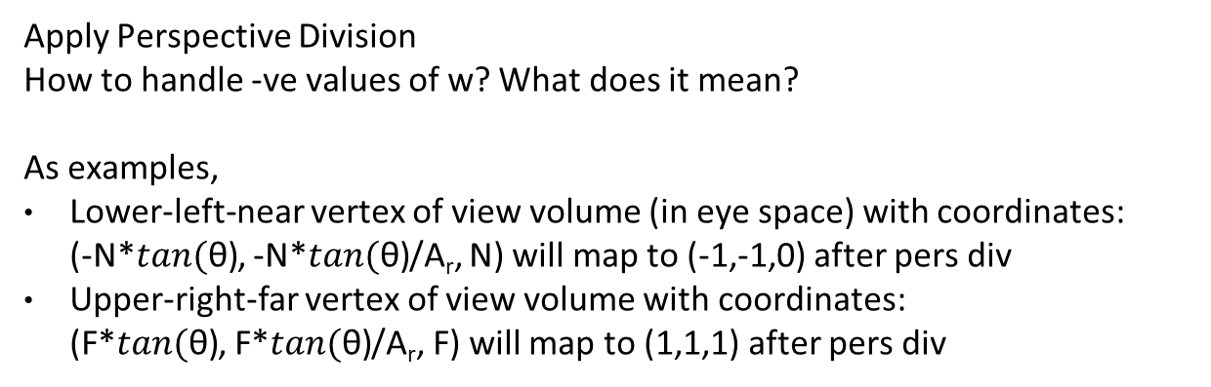
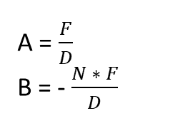
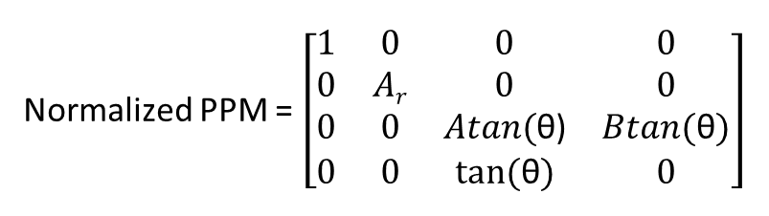
Perspective Projection
Normalized PPM = $\left[\begin{matrix}1 & 0 & 0 & 0 \\ 0 & Ar & 0 & 0 \\ 0 & 0 & Atan\text{(}\text{θ}\text{)} & Btan(\text{θ}) \\ 0 & 0 & tan⁡(\text{θ}) & 0\end{matrix}\right]$
A = $\frac{F}{D}$
B = - $\frac{N ∗ F}{D}$
Apply Perspective Division
How to handle -ve values of w? What does it mean?
As examples,
Lower-left-near vertex of view volume (in eye space) with coordinates: (-N*$tan\text{(}\text{θ}\text{)}$, -N*$tan\text{(}\text{θ}\text{)}$/A_{r}, N) will map to (-1,-1,0) after pers div
Upper-right-far vertex of view volume with coordinates: (F*$tan\text{(}\text{θ}\text{)}$, F*$tan\text{(}\text{θ}\text{)}$/A_{r}, F) will map to (1,1,1) after pers div

Slide 13

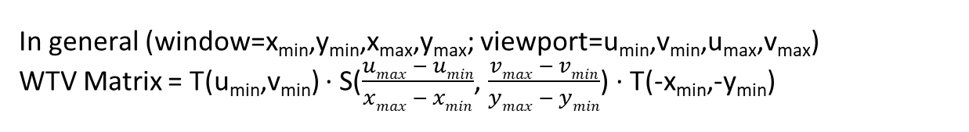
Window-to-Viewport Mapping
Change from normalized volume (xyz) to screen coordinates (XY)
xyz: normalized point after perspective division
XY: screen coordinates
v_{l},v_{b}: lower-left corner of viewport
v_{r},v_{t}: upper-right corner of viewport
WTV Matrix = T((v_{l}+v_{r})/2,(v_{b}+v_{t})/2)*S((v_{r}-v_{l})/2,(v_{t}-v_{b})/2)*T(0,0)
X = x$\frac{vr − vl}{2}+ \frac{vr+ vl}{2}$
Y = y$\frac{vt − vb}{2}+ \frac{vt+ vb}{2}$
In general (window=x_{min},y_{min},x_{max},y_{max}; viewport=u_{min},v_{min},u_{max},v_{max})
WTV Matrix = T(u_{min},v_{min}) · S($\frac{umax − umin}{xmax − xmin}$, $\frac{vmax − vmin}{ymax − ymin}$) · T(-x_{min},-y_{min})

Slide 14
Rendering Pipeline
MODEL
SPACE
Transformation
Matrix (4x4 TM)
WORLD
SPACE
Eye
Matrix (4x4 EM)
EYE
SPACE
Translation, Scaling, Rotation, Shear
Eye, COI, Top/Tilt
Window-To-Viewport Mapping (4x4 WTV)
Projection
Matrix (4x4 PM)
SCREEN
SPACE
(VIEWPORT)
PROJECTION
SPACE
NORMALIZED PROJECTION
SPACE
(WINDOW)
Viewport: lower-left, upper-right
Pers Divide
Aspect Ratio, Half Angle of View, Near, Far

